Slide 1
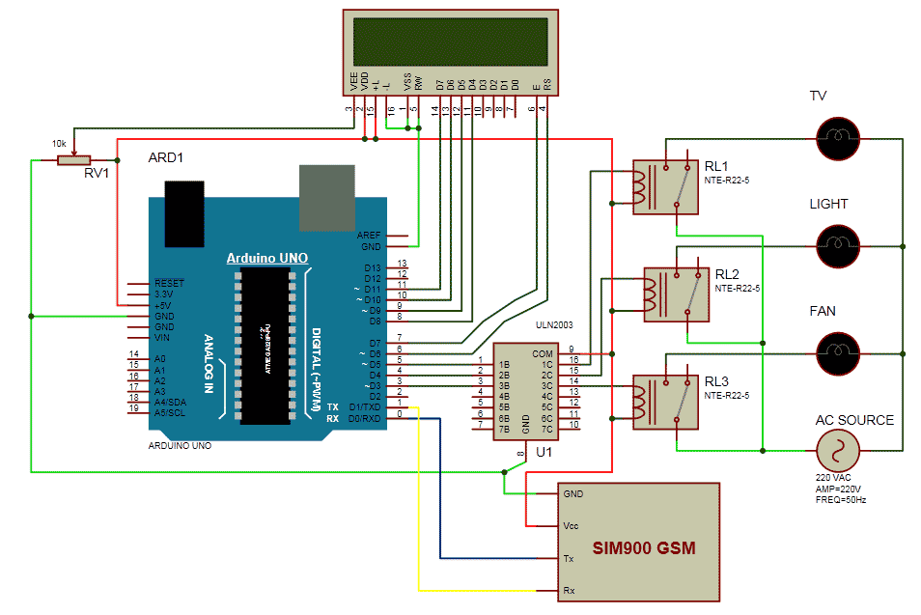
GSM BASED HOME AUTOMATION

Slide 2
GSM BASED HOME AUTOMATION
S.no. | Message | Operation
1 | #H.fan on@ | Fan ON
2 | #H.fan off@ | Fan OFF
3 | #H.light on@ | Light ON
4 | #H.light off@ | Light OFF
5 | #H.tv on@ | TV ON
6 | #H.tv off@ | TV Off
7 | #H.all on@ | All ON
8 | #H.all off@ | All OFF

